Slide 1
IPL-Data-Visualization-TABLEAU
Problem Statement:
The Indian Premier League, or IPL, is a T20 cricket league, which was founded in 2008 and is held every year. It sees participation from both national and international players, and eight teams representing eight Indian cities compete in a double round-robin format in the league stages, which are followed by playoffs. Over the years, IPL has become one of the most watched and most attended live sporting events all over the world.

Slide 2
Analysis:
We will complete our analysis from the following steps:
1. Match Statistics
Toss outcome vs Match outcome (for each Ground/Venue)
Biggest wins (by runs and by wicket)
Highest totals (across all the seasons)
2. Player Statistics
Orange Cap contenders (The batsmen who have scored the maximum number of runs in a particular season)
Purple Cap contenders (The bowlers who have taken the maximum number of wickets in a particular season)
Batsmen who have hit the most number of fours and sixes (per season and overall)
3. Team Statistics
Season-wise team performance (wins vs losses)
Win %age ( home vs away)

Slide 3
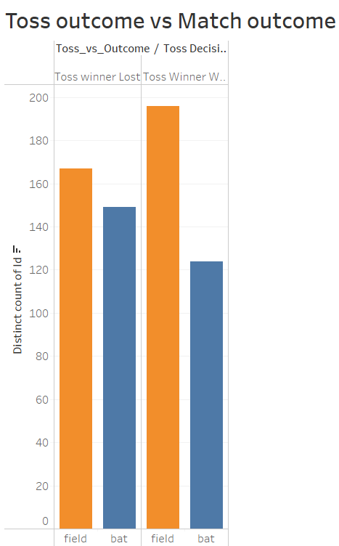
Match Statistics:
1. Toss outcome vs Match outcome (for each Ground/Venue):

Slide 4
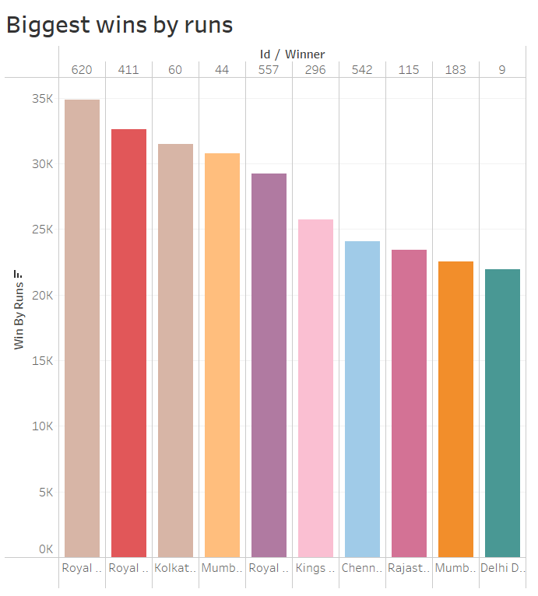
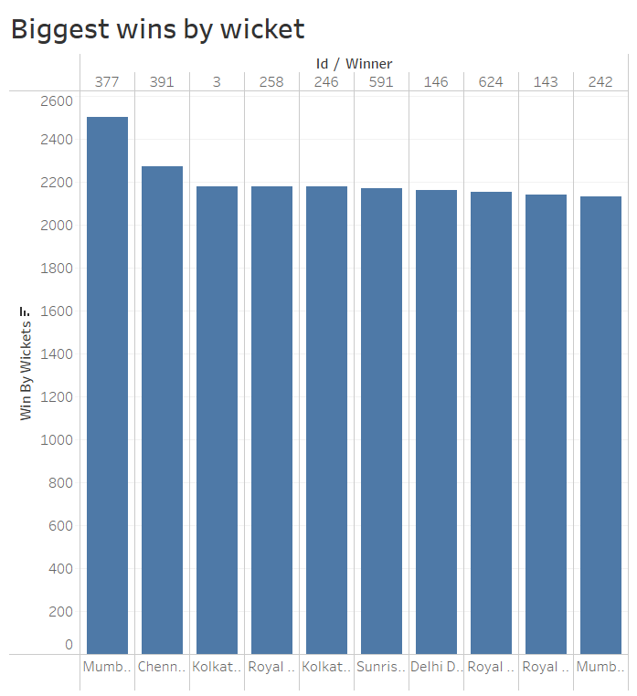
2. Biggest wins (by runs and by wicket)

Slide 5
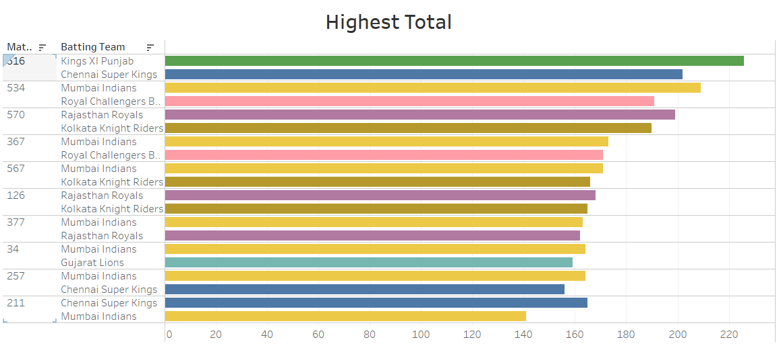
3. Highest totals (across all the seasons)

Slide 6
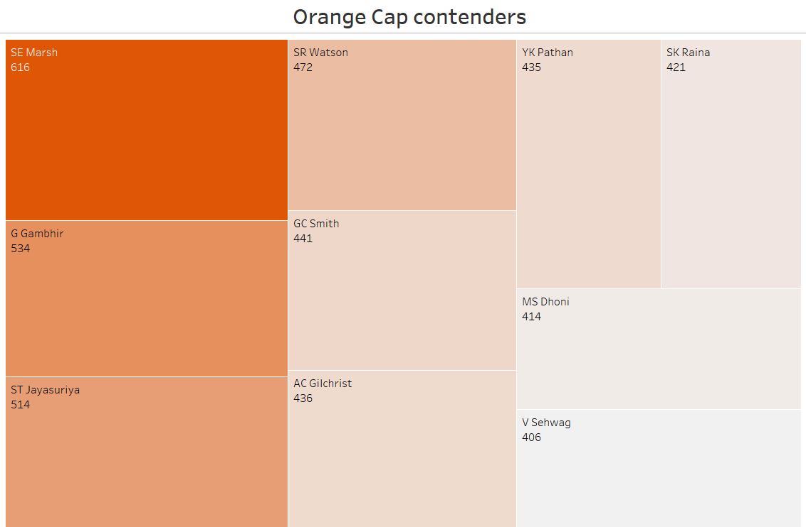
Player Statistics:
1. Orange Cap contenders:

Slide 7
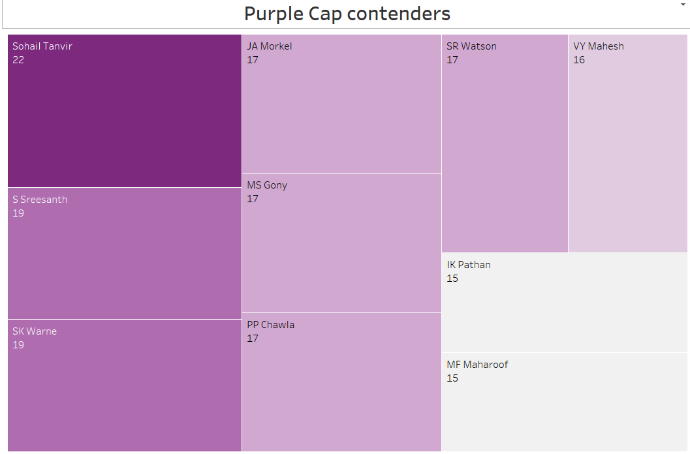
2. Purple Cap contenders (The bowlers who have taken the maximum number of wickets in a particular season)

Slide 8
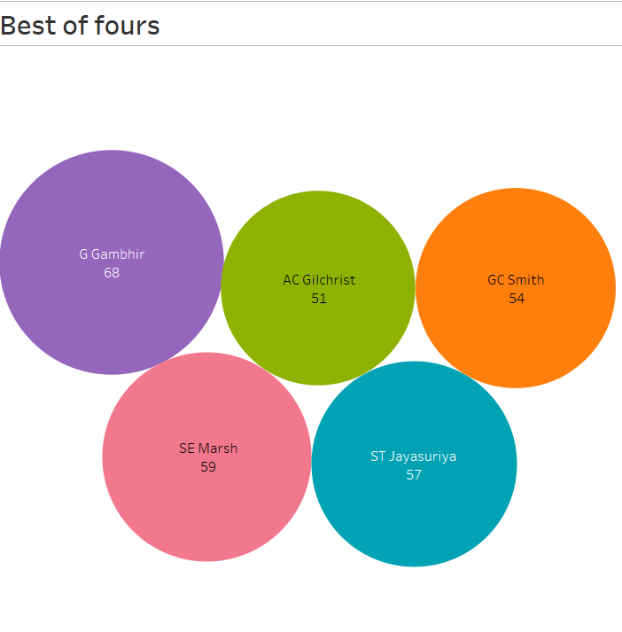
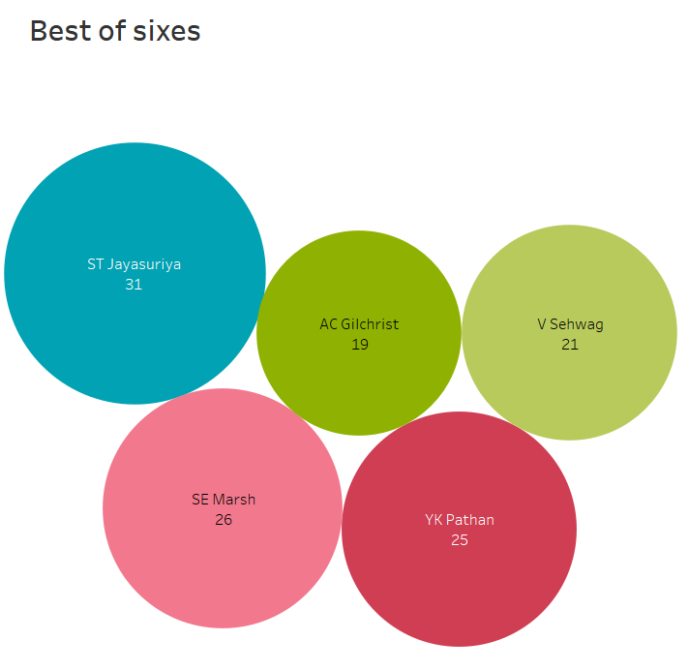
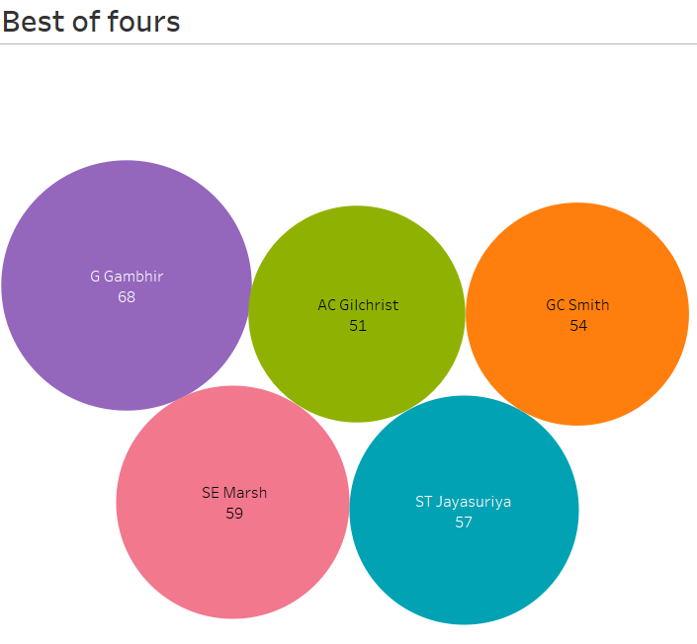
3. Batsmen who have hit the most number of fours and sixes (per season and overall)

Slide 9
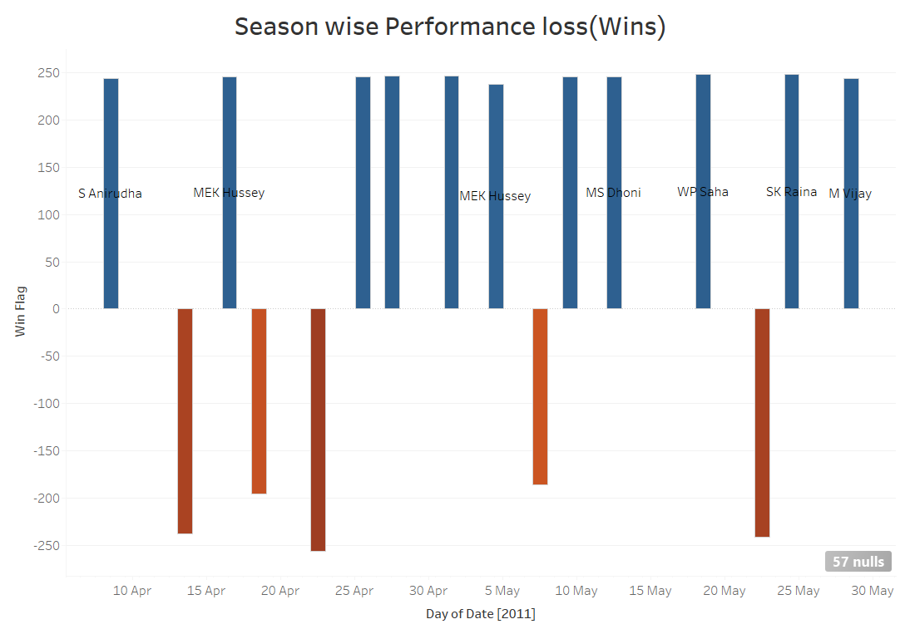
Team Statistics
1. Season-wise team performance (wins vs losses)

Slide 10
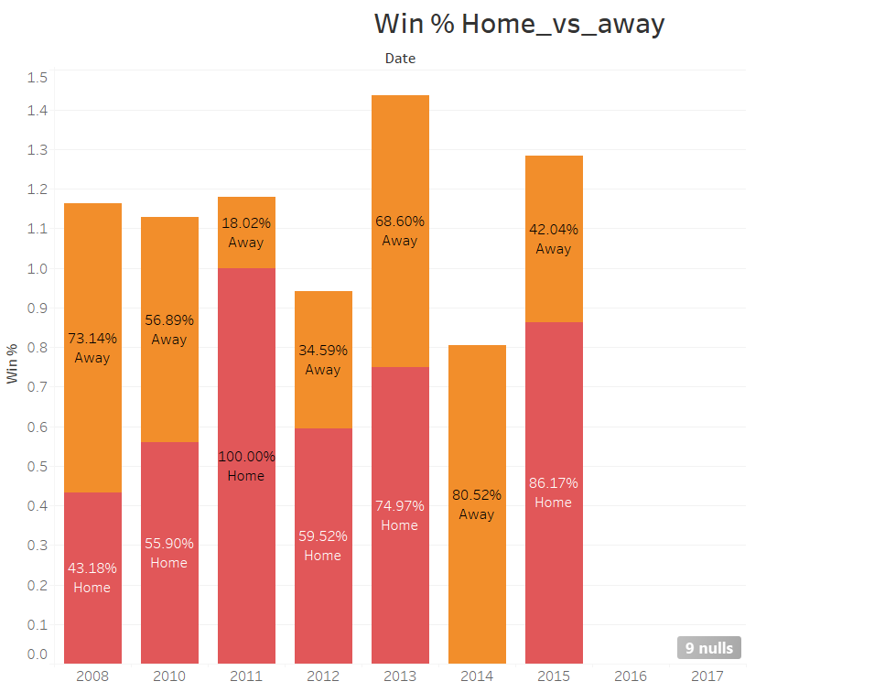
2. Win %age ( home vs away)

Slide 11
Thank You..

